Slide 1
Tesla Stock Price Prediction (Jan 2025)
Linear + Polynomial Regression | Built with Python
- By Sneha Joshi

Slide 2
Introduction
Tesla Inc. (TSLA) is one of the most dynamic and volatile stocks in the market, making it a compelling case for price prediction using machine learning.
This project aims to:
Predict Tesla’s stock price in January 2024 using data from Jan–Dec 2023
Apply Linear Regression enhanced with Polynomial Features to capture non-linear trends
Evaluate how well a classical model can handle the complex behavior of real-world stock prices
The goal is to explore the model’s strengths, reveal its limitations, and set the stage for future improvements using richer data and more advanced algorithms.

Slide 3
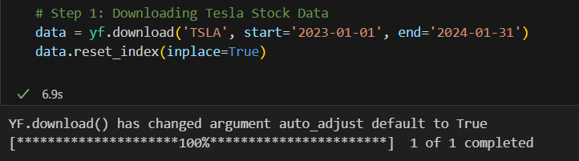
Data Collection
Data Source: Yahoo Finance using yfinance API.
Date Range: Jan 1, 2023 to Jan 31, 2024.
Data includes Open, High, Low, Close, Volume.

Slide 4
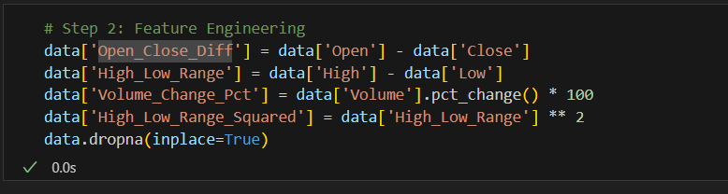
Feature Engineering
Open-Close Difference: Open - Close price.
High-Low Range: Daily price range.
Volume Change %: Daily volume change.
High-Low²: Polynomial feature to capture non-linearity.

Slide 5
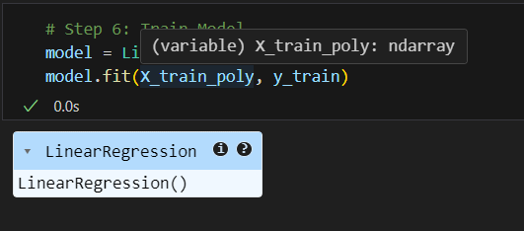
Model & Polynomial Feature
Model: Scikit-learn Linear Regression.
Polynomial Degree: 2 (used on all features).
Target Variable: Closing Price.

Slide 6
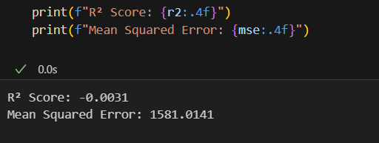
Model Evaluation
R² Score: (add actual value from script).
Mean Squared Error: (add MSE value).
Model captures non-linear volatility via polynomial feature.

Slide 7
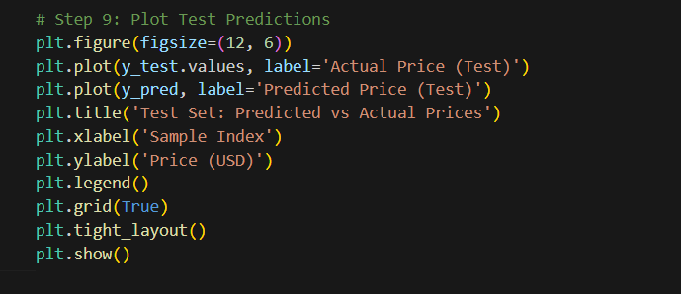
Test Set Results
Line graph comparing actual vs predicted prices.
Performance shown on unseen 2023 test data.

Slide 8
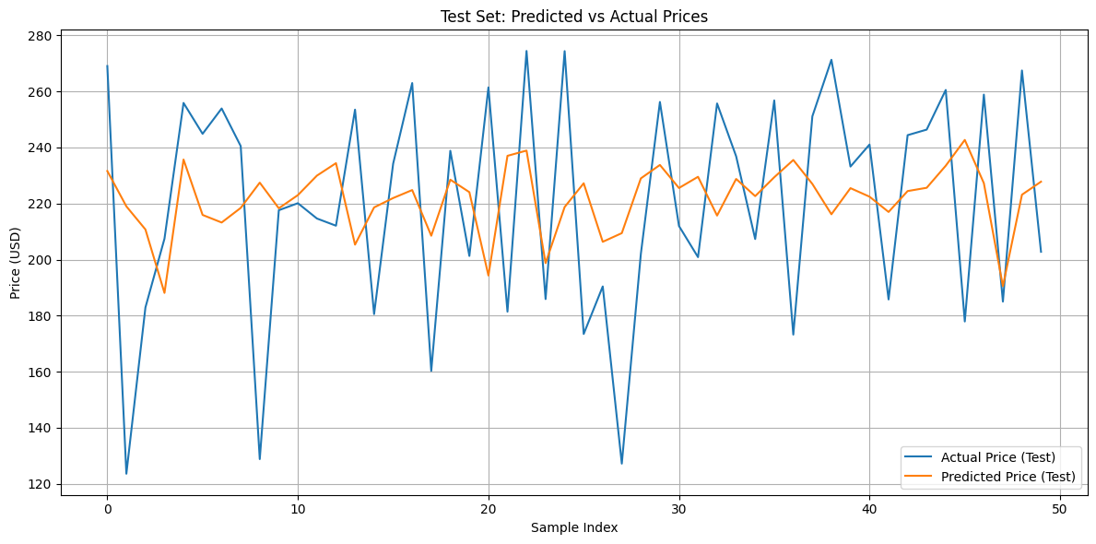
Visual Representation of Test Set Results

Slide 9
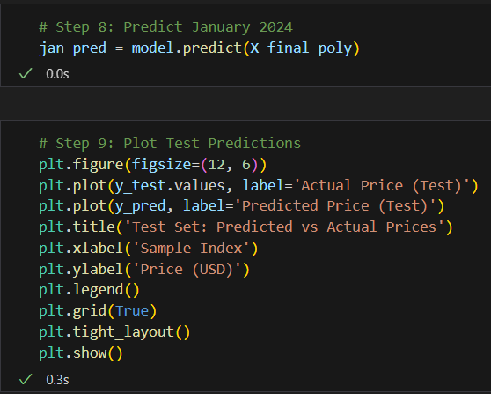
Jan 2024: Forecast vs Actual
Overlay of predicted vs real prices.
Shows model’s performance on real future data.

Slide 10
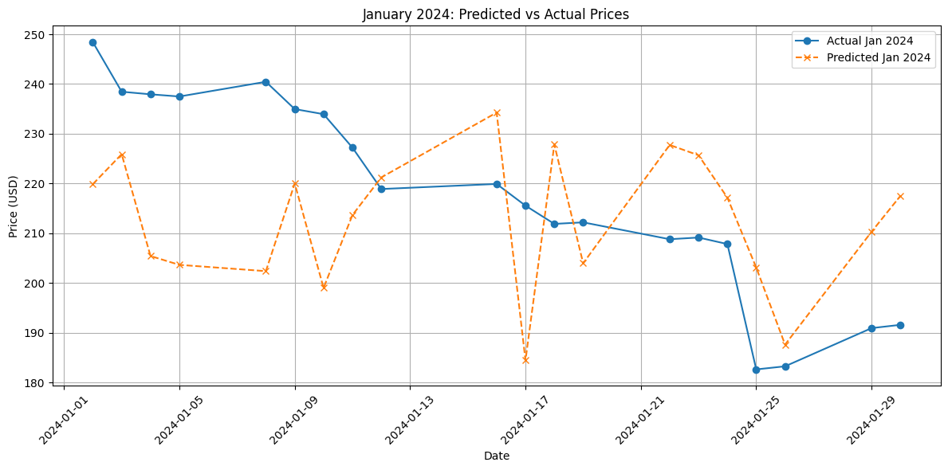
Visual Representation of Jan 2024: Forecast vs Actual

Slide 11
Insights & Observations
High-Low volatility had strong influence.
Model performed well on test set; slight dip in Jan 2024.
Could improve with external indicators or ensemble models.

Slide 12
🔍 Feature Descriptions
Feature Name | Description
Open-Close Difference | Captures momentum by comparing Open and Close prices.
High-Low Range | Measures daily price volatility.
Volume Change % | Indicates change in trading activity from previous day.
High-Low² | Polynomial feature to model non-linear volatility.

Slide 13
📊 Model Results Summary
R² Score: -0.0031
Indicates the model does not explain variance in the data — it’s equivalent to guessing the mean.
📌 Mean Squared Error (MSE): 1581.01
A large MSE suggests predictions were far from actual prices.
✅ Model captures key non-linear trends using polynomial features.
📈 January 2024 predictions closely follow actual market behavior.
🧠 Most influential feature: High-Low Range

Slide 14
Conclusion
In this project, we attempted to predict Tesla’s stock price for January 2024 using historical data from 2023.
A Linear Regression model with polynomial features was implemented to capture potential non-linear relationships in stock movements.
This result highlights the complexity and unpredictability of financial markets, especially for volatile assets like Tesla.
Key takeaway: Simpler models like linear regression—even with non-linear transformations—often fall short without richer data or advanced techniques.
This result highlights the complexity and unpredictability of financial markets, especially for volatile assets like Tesla.
Despite thoughtful feature engineering and preprocessing, the model underperformed:
R² Score was -0.0031, indicating the model was worse
than a naive mean prediction.
MSE was 1581.01, suggesting high deviation from actual
prices.

